Slide 1
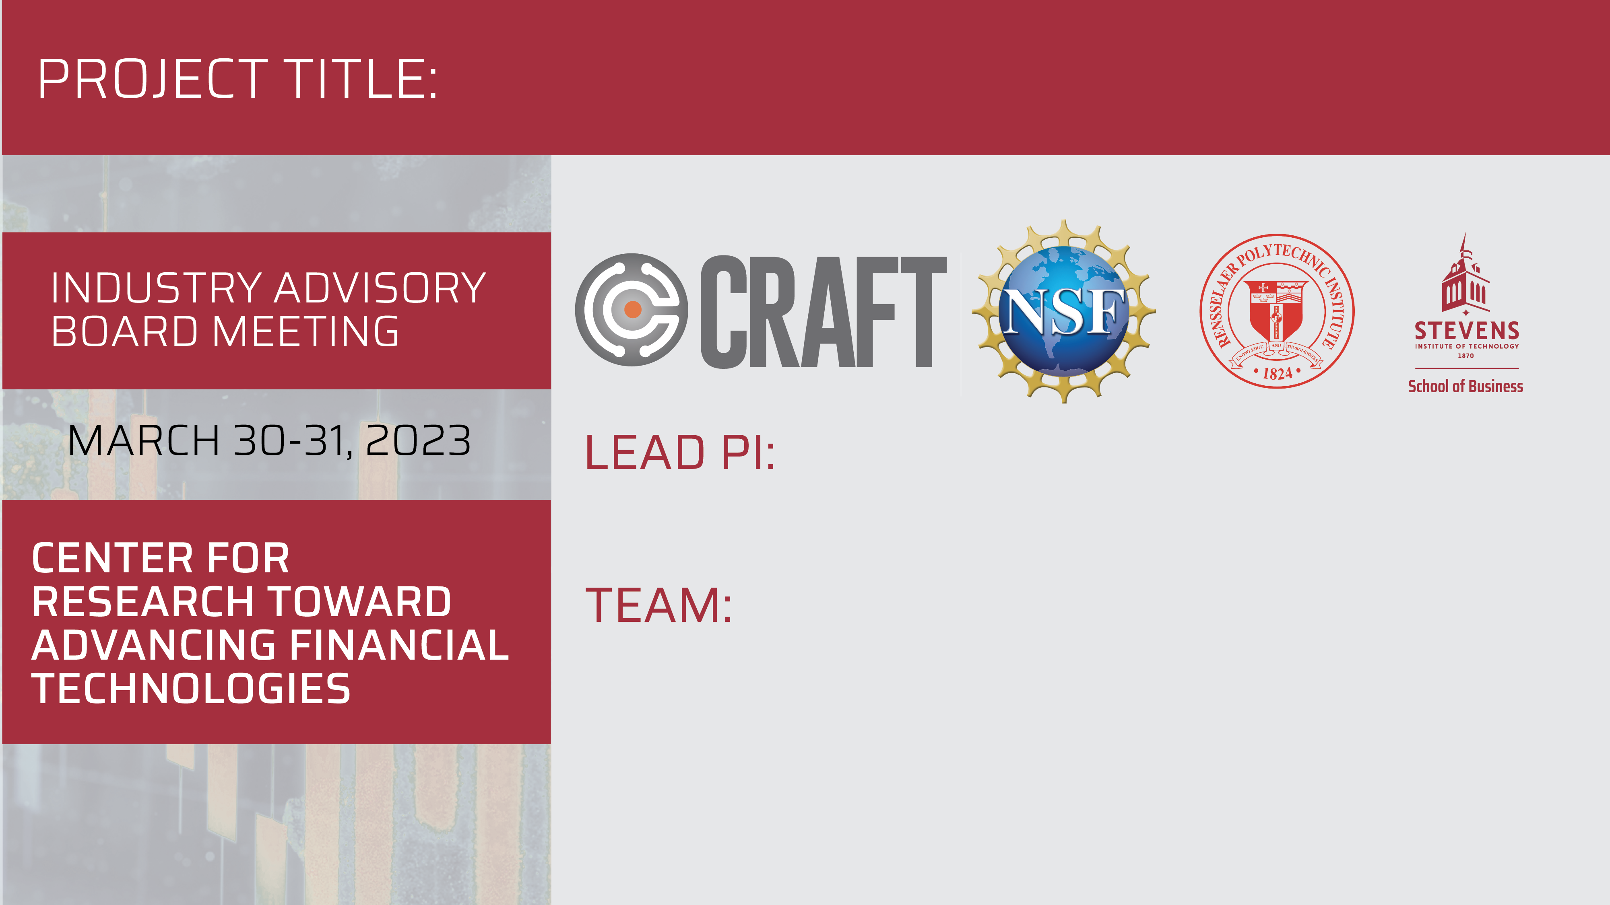
Fast Quantum Methods for Financial Risk Management
Zhenyu Cui, Stevens Institute of Technology
Rupak Chatterjee, Stevens
Chihoon Lee, Stevens
Zhiyang Deng, Stevens

Slide 2

Motivation & Goals
Motivation
1. Since 1960s, quantum computing has always interested physicists and engineers, which accelerated the development of both theory and hardware.
2. Several successful prototypes of quantum machines built by industry convinced people that we can be benefit from such amazing technology, especially within finance.
3. We examine optimal arbitrage detection problem of cryptocurrencies. Inspired by 1QBit’s work, we propose investigating the use of quantum computing techniques combined with QUBO (quadratic unconstrained binary optimization) algorithms to detect optimal arbitrage opportunities in the cryptocurrency market.
4. The successful development of a quantum computing-based algorithm for detecting optimal arbitrage opportunities in the cryptocurrency market could lead to significant benefits in terms of reduced latency, increased profitability, and more efficient market functioning.

Slide 3
Motivation & Goals
Goals
The primary objective of this research is to develop a QUBO-based algorithm for detecting optimal arbitrage opportunities in the cryptocurrency market using quantum computing techniques. To achieve this, we have outlined the following research goals:
1. Following the QUBO formulation presented in 1QBit’s whitepaper, considering the constraints of conservation of flow and the pass-through constraint.
2. Implement the QUBO-based algorithm for detecting optimal arbitrage opportunities using gate-based quantum computers (the QAOA under IBM machine) and using single-purpose quantum annealer (D-wave machine).
3. Create an AlphaQUBO implementation of the optimal arbitrage detection algorithm. AlphaQUBO is an open-source framework for solving QUBO problems using classical computing resources.
4. By comparing the performance of the quantum computing-based algorithms with the AlphaQUBO implementation, we can evaluate the advantages and drawbacks of quantum vs. classical computing methods for this problem.

Slide 4
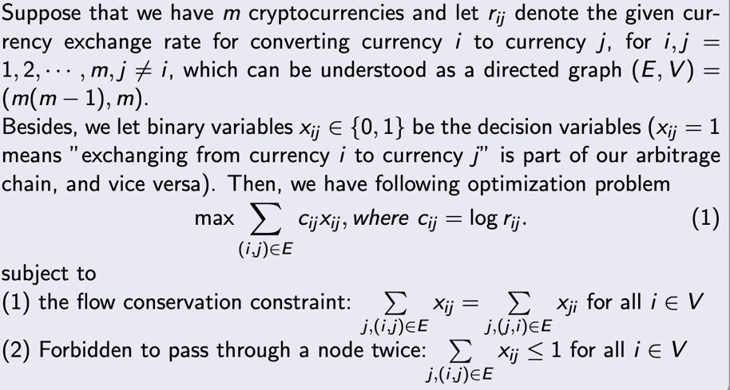
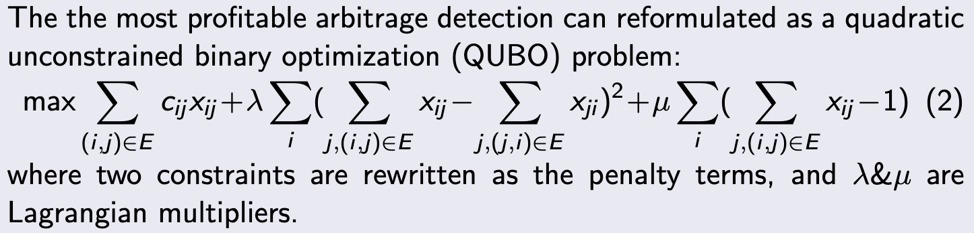
Progress on Tasks
Task 1 Progress (Problem formulation and data source choice)
a) Problem Formulation is summarized below:

Slide 5
Progress on Tasks
b) Kaiko is a valuable data source for cryptocurrencies, providing extensive coverage, granular data, and high-quality, reliable information.
Its user-friendly API and custom data solutions make it an ideal choice for stakeholders in the cryptocurrency ecosystem looking to access accurate and comprehensive market data for their trading, research, or analysis needs.
Kaiko covers data from over 100 cryptocurrency exchanges and thousands of trading pairs, providing comprehensive access to global market data.

Slide 6
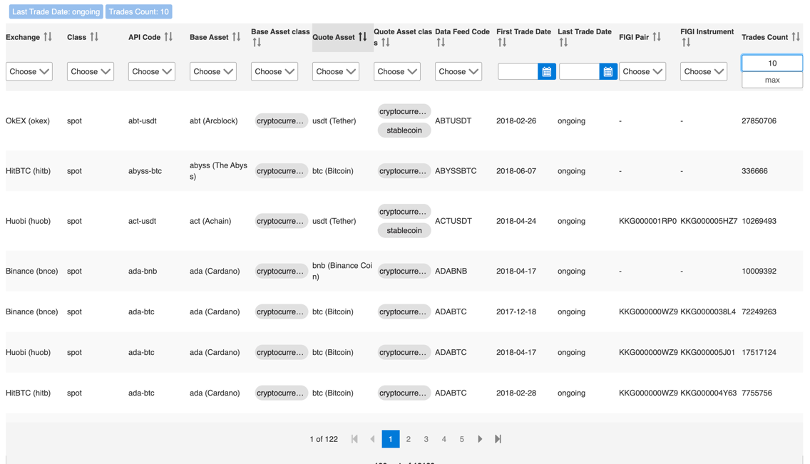
Progress on Tasks
Example for the cryptocurrencies data that can be provided by Kaiko:

Slide 7
Progress on Tasks
Task 2 Progress (Implementation of Quantum Annealing)
We choose four different cryptocurrencies (Bitcoin, ETH, BCH, LTC) for numerical experiment.
The data we choose is Order Book Aggregation data (daily price) and time interval we choose is one month (30 days) interval (from 2023-02-22 to 2023-03-24).
Here we choose the best bid and ask price (highest bid price and lowest ask price) for each currency and calculate their exchange rates
Examples of 10 day data is shown on the next slide.

Slide 8
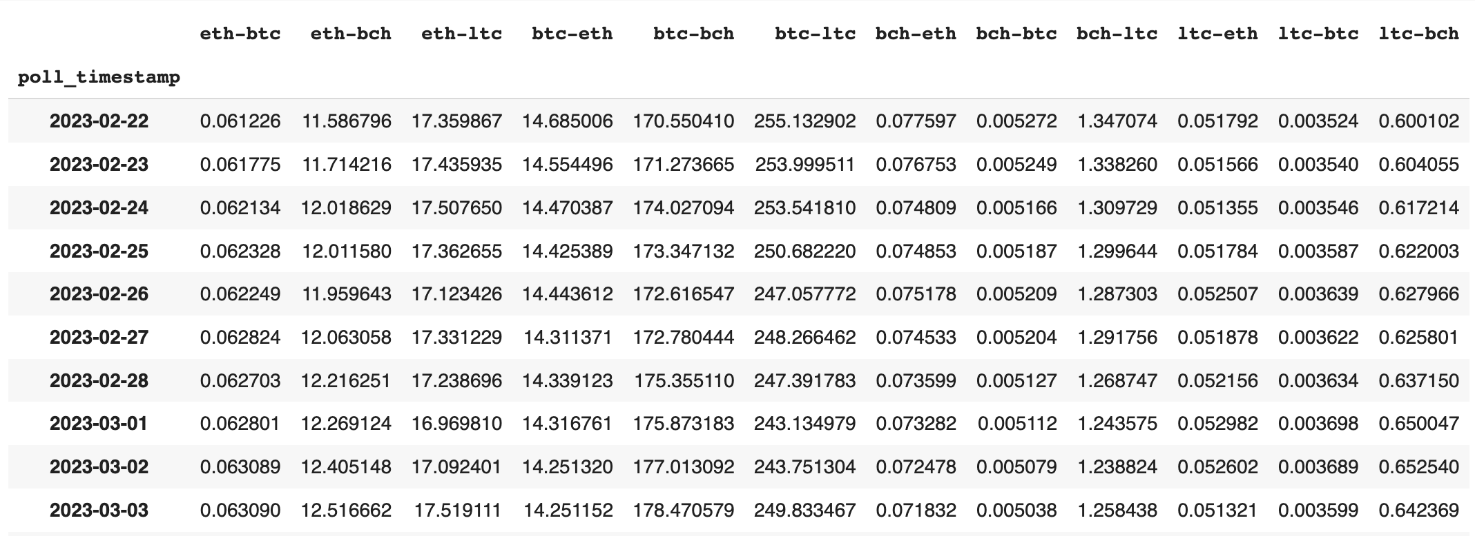
Progress on Tasks

Slide 9
Progress on Tasks
Task 2 Progress
We implement QUBO-based algorithm under D-Wave 2000Q_6 machine and compared the numerical result with algorithm under classical computing.
The classical algorithm we use is to traverse all the possibilities of trading cycle among all four cryptocurrencies and then to find out the most profitable one.

Slide 10
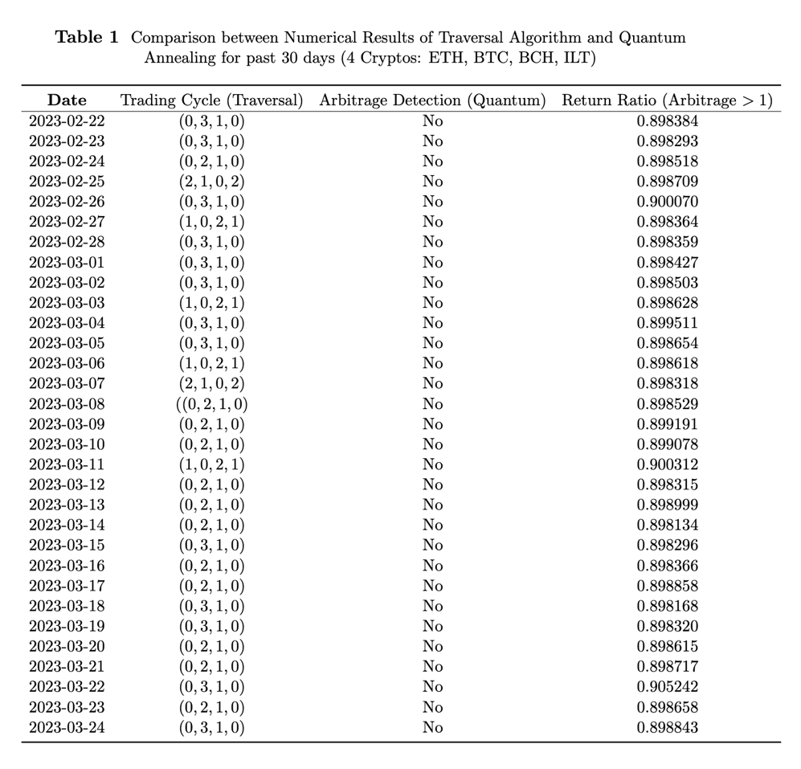

Slide 11
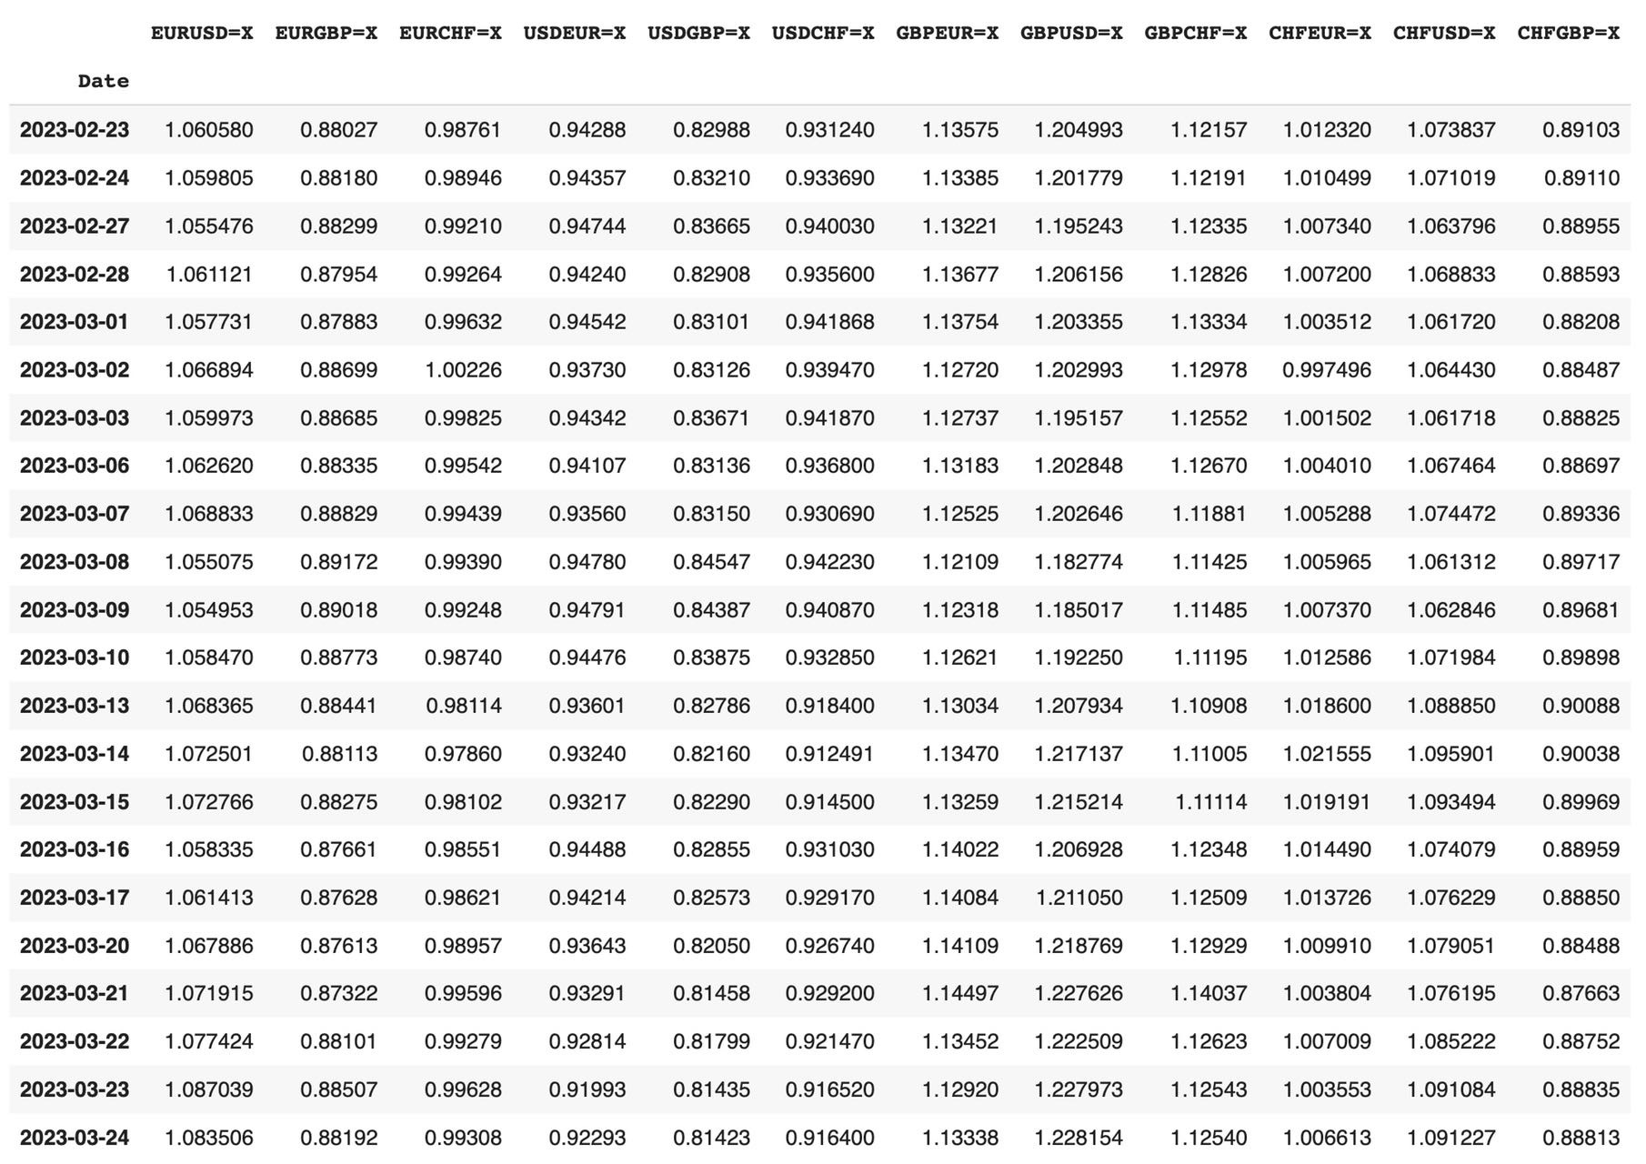

Slide 12
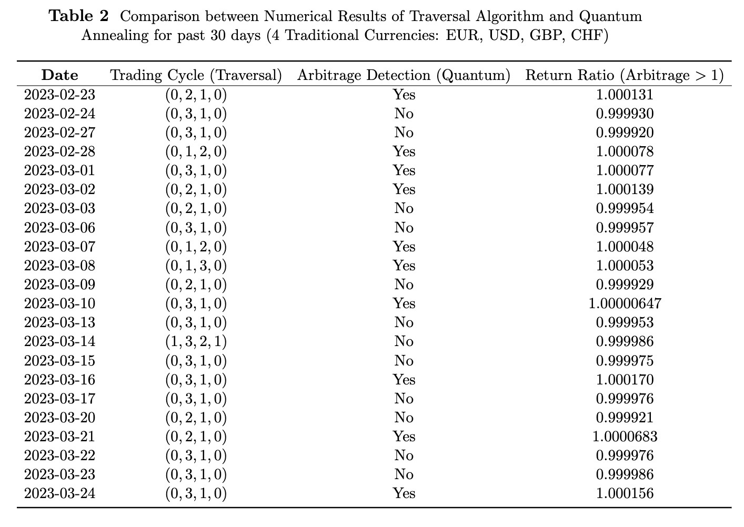

Slide 13
Progress on Tasks
Task 3 Progress (Implementation of QAOA and AlphaQUBO)
Numerical Experiment on QAOA is in progress, still undergoing debugging in numerical implementations.

Slide 14
Deliverable Completion
Deliverables for Task 1
The correctness of problem formulation has been checked, and Kaiko has been established as a suitable data source for our research purpose.
Deliverables for Task 2
The task 2 shows that the consistency between classical algorithms and quantum algorithms on very recent dataset of cryptocurrencies and validity of quantum algorithms.
Deliverables for Task 3
Numerical Experiment on QAOA is in progress, debugging is carried out on numerical results.

Slide 15
Plan for Future Milestones
The QAOA method is being implemented and at debugging stage. We are investigating the AlphaQUBO to be able to implement it.
We shall also involve more types of currencies, and also a portfolio of currencies involving both traditional currencies and crypto currencies.
We anticipate that the above tasks will need more computing time from D-Wave machines and we shall purchase more running time from them.

Slide 16
Risks, Challenges, and Roadblocks
Mitigation Plan:
We are in the process of seeking to purchase more running times on D-Wave machine.
The PhD student Zhiyang Deng is working to code in AlphaQUBO.
We shall later consider high dimensional problems after all the above methods have been implemented.
Risks
Our problems are still in low dimension, we have not done the research for high dimensional problems.
Challenges
AlphaQUBO is NOT as user-friendly as other tools.
Roadblocks
Limited Running times on both D-Wave machine and IBM machine.

Slide 17


